Slide 1
Athlete's foot
Athlete's foot (Tinea pedis) is the most prevalent cutaneous fungal infection in human that is common in adult transmitted in moist or humid locations.
Location: Classically, the toes are involved, the web space between the fourth and fifth toes being the most commonly affected. More severe infections may spread to the sole of the foot and even to the upper surface in some cases that need referral.

Slide 2
Fungal infection according to site
Scalp ------Tinea capitis
Feet ---------Tinea pedis
Groin ---------Tinea cruris
Body ----------Tinea corporis
Nails --------Tinea unguium (onychomycosis

Slide 3
Appearance:
The skin in the web spaces appears white and (soggy). The area is normally itchy and the feet tend to smell.
The skin become macerated and begin to peel off and the underneath skin usually reddened and may be sore.
Severity:
Severe athlete's foot [broken and macerated skin with signs of bacterial involvement (weeping, pus or yellow crusts) required referral

Slide 4
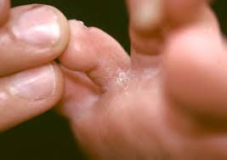
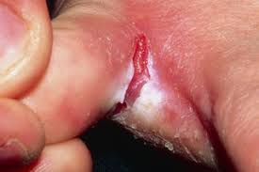

Slide 5
Conditions to eliminate
Immunocompromised patients present with athlete's foot are best referred
Diabetics may have impaired circulation or innervation of the feet and are more prone to secondary infections in addition to poorer healing of open wounds
Involvement of toenails (see Tinea unguium)---referral.

Slide 6
practical advice to prevent reinfection
1-Clean the skin daily with soap and water. Dry the skin thoroughly after bath. Don’t share personal towel.
2-Socks should frequently change and washed regularly. Cotton sock can facilitate the evaporation of moisture, whereas nylon socks not.
3-Avoid wearing occlusive, non-breathable shoes in summer, open toe sandals can be helpful and shoes should be left off where possible.
4-Applying antifungal foot powder daily can protect against athletets infection

Slide 7
Management
Topical Antifungals generally advise use for 1–2 weeks after the disappearance of all signs of infection
1-Azoles (e.g. clotrimazole, ketoconazole and miconazole)
Topical azoles can be used to treat many topical fungal infections, including athlete’s foot.
They have a wide spectrum of action and have been shown to have both antifungal and antibacterial activity. So its useful for secondary infection.
SE: cause mild irritation of the skin

Slide 8
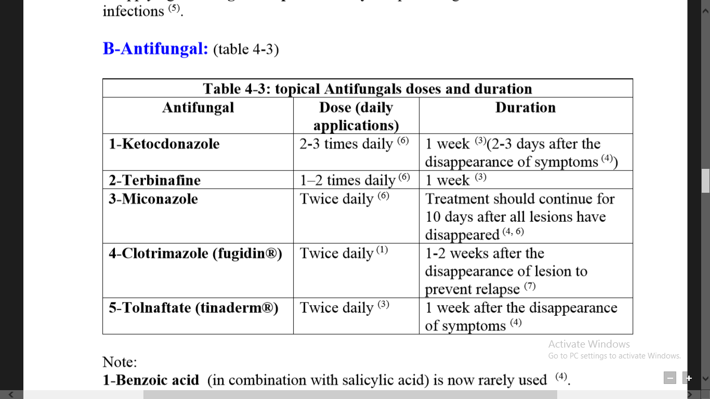

Slide 9
Tolnaftate
Available in powder, cream, aerosol and solution formulations and is effective against athlete’s foot.
It has antifungal, but not antibacterial, action.
It should be applied twice daily and treatment should be continued for up to 6 weeks.
SE: Tolnaftate may sting slightly when applied to infected skin.

Slide 10
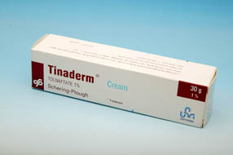
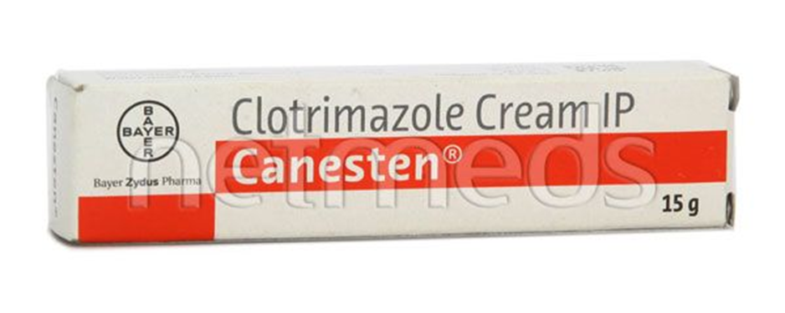

Slide 11
Terbinaﬁne
cream, solution, spray and gel formulations.
There is evidence that terbinaﬁne is better than the azoles in preventing recurrence, so it will be useful for frequent athlete’s foot.
Terbinaﬁne can cause redness, itching and stinging of the skin;
contact with the eyes should be avoided.
Terbinaﬁne products are not recommended for use in children.

Slide 12
Antifungal/steroid combination:
1- Miconazole 2% with hydrocortisone 1% (Daktacort) 2- Clotrimazole 1% with Hydrocortisone 1% (Canesten-H)
Maximum period of treatment is 7 days. After that continue with topical antifungal
Note: Topical steroid alone not recommended. Why?

